Slide 1
Case Study-1
Sundarbans's Vanishing Shores
Notes:
Please refer to page 143 in the “environmental reader” textbook for more information.
Other good sources to refer to are:
https://www.thethirdpole.net/en/2018/01/17/sinking-sundarbans-islands-underline-climate-crisis
https://www.npr.org/sections/parallels/2016/05/23/478393443/the-vanishing-islands-of-indias-Sundarbans
https://scroll.in/article/865138/in-sundarbans-rising-sea-levels-have-turned-farms-into-wasteland-threatening-to-displace-millions
Slides prepared by Shaurya Rahul Narlanka

Slide 2
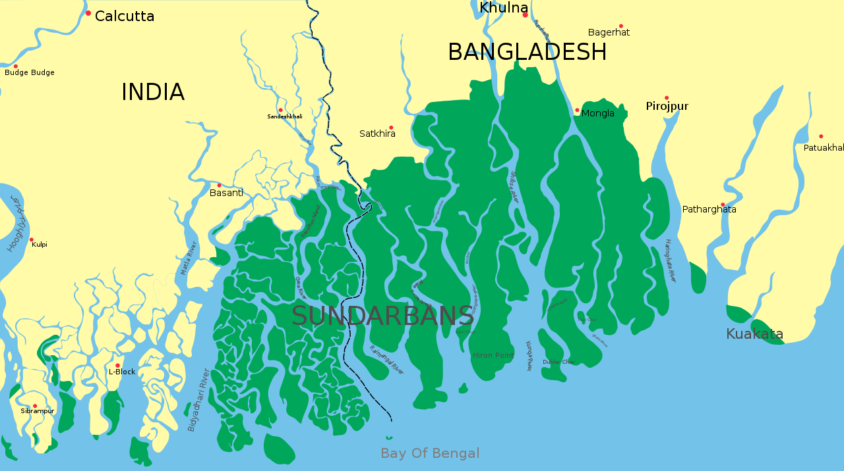
What are the Sundarbans?
wikimedia
Notes:
Sundarbans are a low lying mangrove forests which stretches the coast of Bangladesh and some of West Bengal in India. They are the world’s largest single block of mangrove forest. It is on the delta formed by three large rivers; Ganga, Brahmaputra and Meghna (A major river that resides exclusively in Bangladesh). It’s composed of five national parks: The Sundarbans National Park, Sundarbans, south, west and east wildlife sanctuaries and the Sajnakhali Wildlife Sanctuary. First four are UNESCO world heritage sites. Due to the plethora of unique ecosystems that the Sundarbans harbor, it is home to enumerable biodiversity. It is also home to thousands of people who reside on its many archipelagos and subsist by farming, using/selling non-timber forest products and plantation products.

Slide 3
Sundarbans
Sundarbans are a low lying mangrove forests which stretches the coast of Bangladesh and some of West Bengal in India. They are the world’s largest single block of mangrove forest. It is on the delta formed by three large rivers; Ganga, Brahmaputra and Meghna (A major river that resides exclusively in Bangladesh). It’s composed of five national parks: The Sundarbans National Park, Sundarbans, south, west and east wildlife sanctuaries and the Sajnakhali Wildlife Sanctuary. First four are UNESCO world heritage sites. Due to the plethora of unique ecosystems that the Sundarbans harbor, it is home to enumerable biodiversity. It is also home to thousands of people who reside on its many archipelagos (Island clusters) and subsist by farming, using/selling non-timber forest products and plantation products.

Slide 4
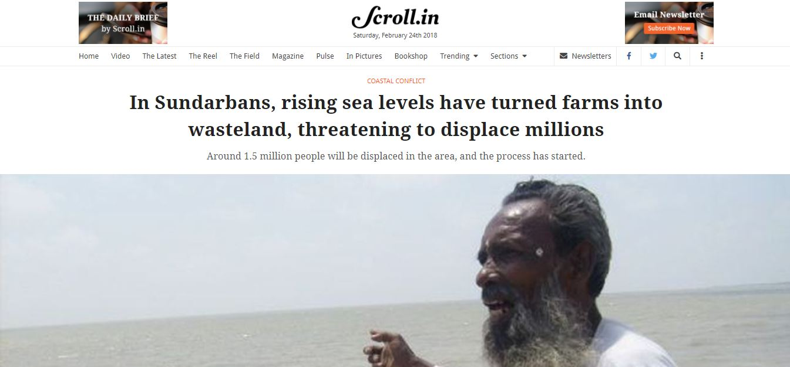
Notes:
Unfortunately due to sea level rise are causing havoc to its ecology and the lives of the people who live in it. This is a serious problem for India in three major ways. First is that the Sundarbans on the Indian side is also inundating. This will cause massive loss of homes and livelihood for many people which the government will have to compensate for. This is not an easy task. Second is that the inundation on the Bangladesh side will trigger an influx of environmental refugees into India from Bangladesh. This is a very serious socio-political issue. It increases burden on the Indian government already stretched funds to manage those refugees and intensifies the political tensions between India and Bangladesh.
Third is the ecological consequences of the inundation. Sundarbans are home to some very critically endangered flora and fauna like the Bengal Tiger, Salt Water Crocodiles, Masked Finfoot and Heritiera fomes (Locally called Sundri) among many many others. The reduction in the size of the forest is already increasing man-wildlife conflicts, especially with the tigers and is causing rapid deterioration of the population of many animals and plants. Their conservation is crucial for the protection of the Sunderbans and the many services we receive from it.

Slide 5
Unfortunately due to sea level rise are causing havoc to its ecology and the lives of the people who live in it. This is a serious problem for India in three major ways. First is that the Sundarbans on the Indian side is also inundating. This will cause massive loss of homes and livelihood for many people which the government will have to compensate for. This is not an easy task. Second is that the inundation on the Bangladesh side will trigger an influx of environmental refugees into India from Bangladesh. This is a very serious socio-political issue. It increases burden on the Indian government already stretched funds to manage those refugees and intensifies the political tensions between India and Bangladesh.

Slide 6
Third is the ecological consequences of the inundation. Sundarbans are home to some very critically endangered flora and fauna like the Bengal Tiger, Salt Water Crocodiles, Masked Finfoot and Heritiera fomes (locally called Sundri) among many many others. The reduction in the size of the forest is already increasing man-wildlife conflicts, especially with the tigers and is causing rapid deterioration of the population of many animals and plants. Their conservation is crucial for the protection of the Sunderbans and the many services we receive from it.

Slide 7
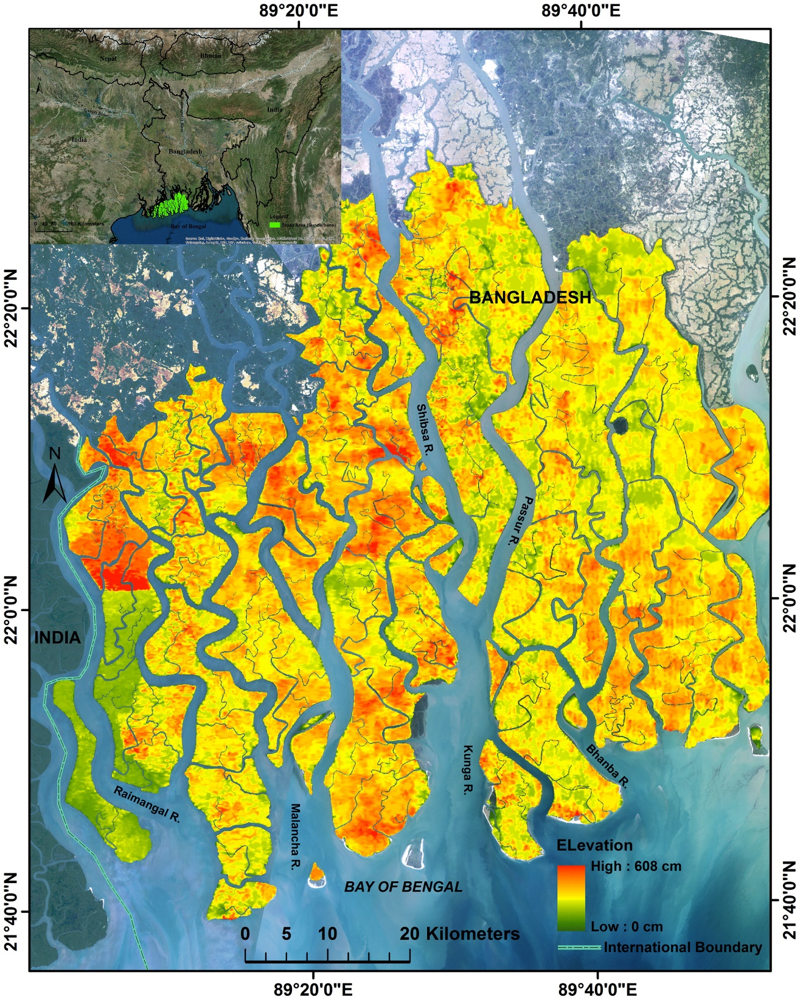
Elevation of the Sundarbans
Ghosh, Manoj Kumer et. al (2019)
Notes:
It is crucial to understand how low the Sundarbans actually are to actually understand the scope of this problem. This is an elevation map of the Sundarbans. As you can see, the highest parts of it are merely 6m over mean seal level with many of the regions being much lower (with not an insignificant area at the mean seal level). This is compounded by the fact that this area naturally subsides due to consolidation of the river deposits in the delta and the erosion of the tidal flats. So the elevation of many areas within the Sundarbans is expected to become lower. Just for a perspective, Manipal is 73m over the mean sea level. Bangalore is at an average 920m over the mean sea level.
Citation: Ghosh, Manoj Kumer, Lalit Kumar, and Philip Kibet Langat. "Geospatial modelling of the inundation levels in the Sundarbans mangrove forests due to the impact of sea level rise and identification of affected species and regions." Geomatics, Natural Hazards and Risk 10, no. 1 (2019): 1028-1046.

Slide 8
It is crucial to understand how low the Sundarbans actually are to actually understand the scope of this problem. This is an elevation map of the Sundarbans. As you can see, the highest parts of it are merely 6m over mean seal level with many of the regions being much lower (with not an insignificant area at the mean seal level). This is compounded by the fact that this area naturally subsides due to consolidation of the river deposits in the delta and the erosion of the tidal flats. So the elevation of many areas within the Sundarbans is expected to become lower. Just for a perspective, Manipal is 73m over the mean sea level. Bangalore is at an average 920m over the mean sea level.

Slide 9
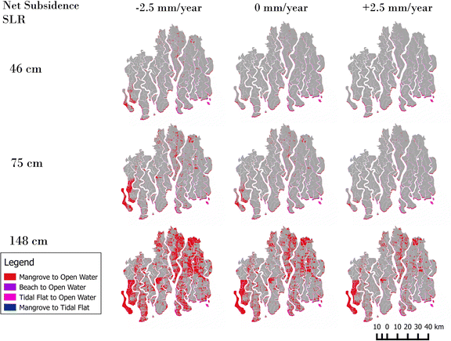
How much inundation are we looking at?
(By 2100)
Payo, Andres, et al (2016)
Notes:
This is the inundation scenario under various natural net subsidence rates (range =+- 2.5mm a year) and various Sea level rise(SLR) scenarios (46-low, 75-medium, 148-high). Which one should we take as a realistic prediction? The area in red color is the inundated area by 2100 under various scenarios.
Citation: Payo, Andres, et al. "Projected changes in area of the Sundarban mangrove forest in Bangladesh due to SLR by 2100." Climatic Change 139.2 (2016): 279-291.

Slide 10
This is the inundation scenario under various natural net subsidence rates (range =+- 2.5mm a year) and various Sea level rise(SLR) scenarios (46-low, 75-medium, 148-high). Which one should we take as a realistic prediction? The area in red color is the inundated area by 2100 under various scenarios.
Citation: Payo, Andres, et al. "Projected changes in area of the Sundarban mangrove forest in Bangladesh due to SLR by 2100." Climatic Change 139.2 (2016): 279-291.

Slide 11
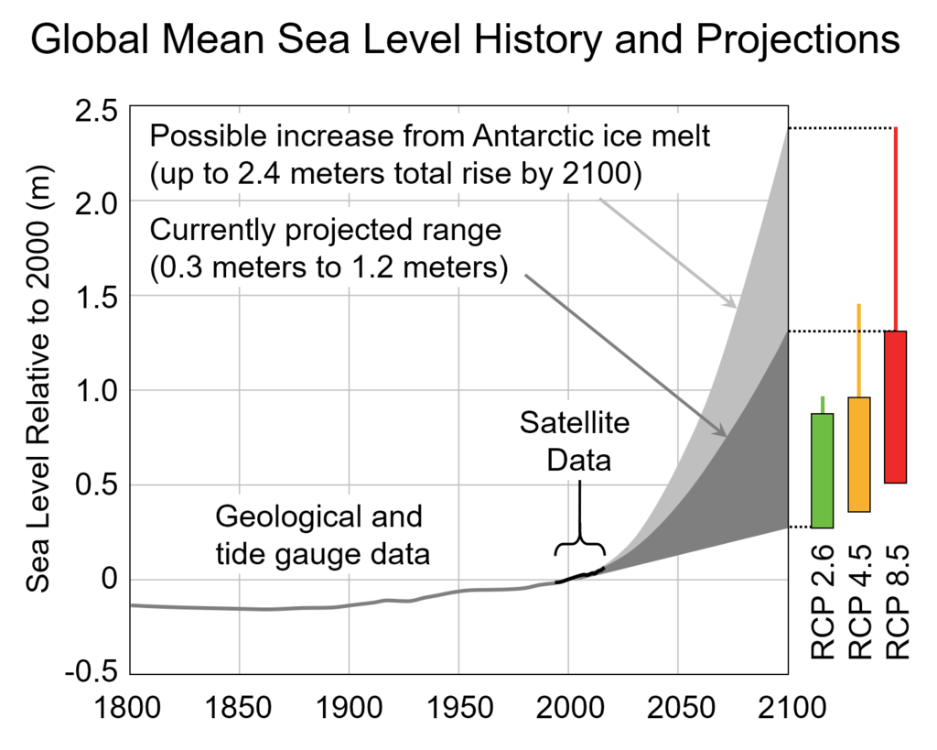
Representative concentration pathway – Green house gas concentration trajectory
Sweet, William V., et al (2017)
Notes:
According to global mean sea level projections using various models, we are realistically looking at 1-1.5m rise in mean sea level, if not more. What will be left of the Sundarbans if our worst case scenario (~2.5m level rise due to Antarctic ice melt) becomes true?
You can read the full report from where this graph was taken here: https://tidesandcurrents.noaa.gov/publications/techrpt83_Global_and_Regional_SLR_Scenarios_for_the_US_final.pdf

Slide 12
According to global mean sea level projections using various models, we are realistically looking at 1-1.5m rise in mean sea level, if not more. What will be left of the Sundarbans if our worst case scenario (~2.5m level rise due to Antarctic ice melt) becomes true?

Slide 13
Solutions?
Zoning according to vulnerability
Planning, rehabilitation and relocation
Embankments
Creating opportunities that do not depend on nature
Read page 144 from the environmental reader book for more details on the solutions.
Notes:
Please read page 144 from the environmental reader book for more details on the solutions.

